Slide 1
WHO are we as a Nation and WHAT do we stand for?
73% of US citizens believe climate change is happening today while 69% of them are worried about it. 2019 Yale Climate Change Communication
In 2005 the #metoo Movement was started to raise awareness of sexual assault and harassment in society. Company culture is important to employees because workers are more likely to enjoy their time in the workplace when they feel safe and fit in with the company culture. Employees tend to enjoy work when their needs and values are consistent with those in the workplace.
Corporations often hire lobbyists to spread donations along political boundaries with a goal of influencing elections and governing policies. 2010 Supreme Court ruled that US corporations can spend unlimited amounts as is their right to free speech. US individuals are limited to $5,000 donations. 2010 Citizens United vs. Federal Elections

Slide 2
Facts Matter!
In 2015, Nielsen polled 30,000 consumers in 60 countries around the world about what influences how people feel about brands, and how those feelings impact buying behavior. #1 response: sustainability
This is especially true for Millennials. While 66 percent of global consumers are willing to pay more for sustainable goods, a full 73 percent of Millennials are. (Nielsen defines Millennials as those born from 1977 to 1995).
A recent study by the Pew Research Center found that the #MeToo hashtag was used more than 19 million times on Twitter since the original tweet. That’s more than 55,000 uses of the hash tag per day = heightened awareness
Forbes 2018 article stated that nearly all employees surveyed felt a safe and positive corporate culture was important to their overall satisfaction
Three factors influence voters' decisions at the polls: partisan loyalty, issues, and candidate characteristics. Partisan loyalty predisposes voters in favor of their party's candidates and against those of the opposing party.

Slide 3
Stand By Your Brand
What are WE going to do about it?
We can VOTE, PROTEST or Purchase goods from companies that support your values
Brand Awareness App
Provides consumers with the knowledge they need to make more informed decisions.
Consumer brand awareness supports consumers when purchasing and supporting brands that align with the consumers values and beliefs.

Slide 4
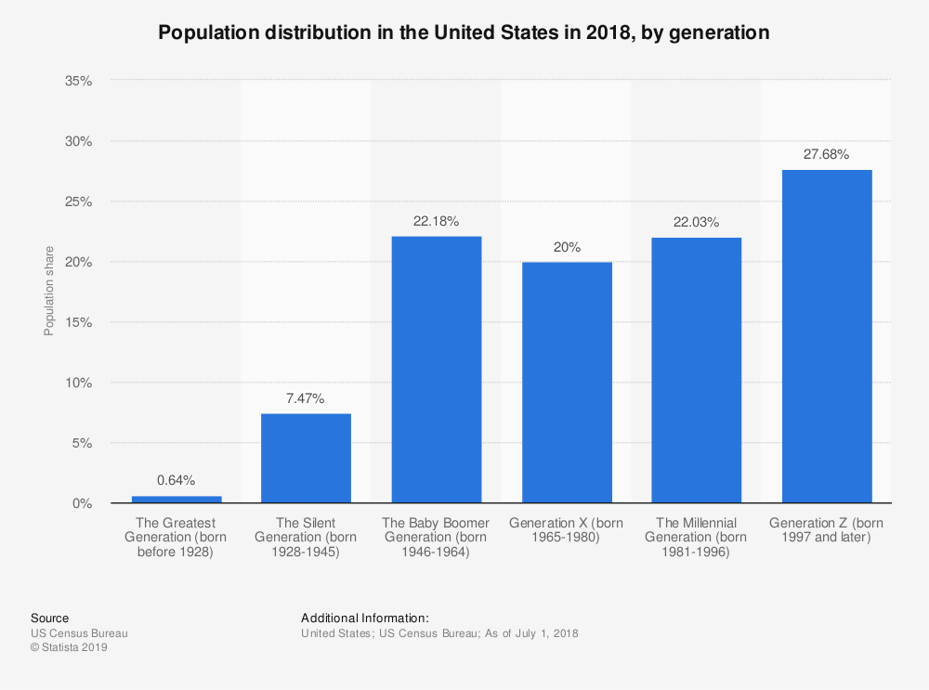
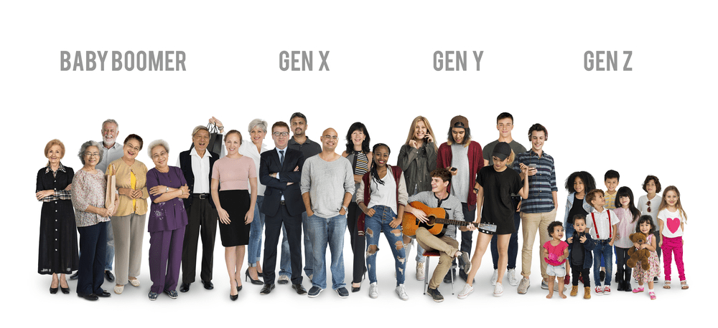
Target Market Opportunities
75.4 Milo
67 Milo
83 Milo
63 Milo

Slide 5
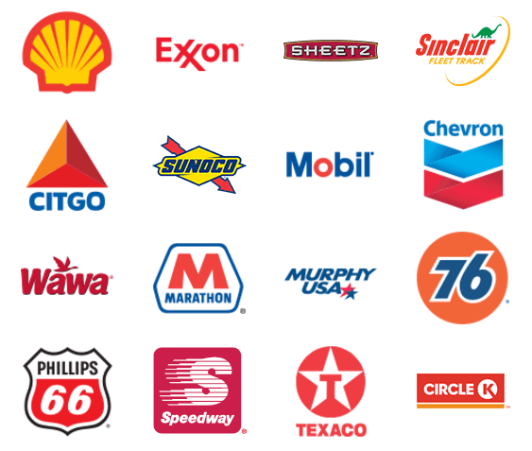
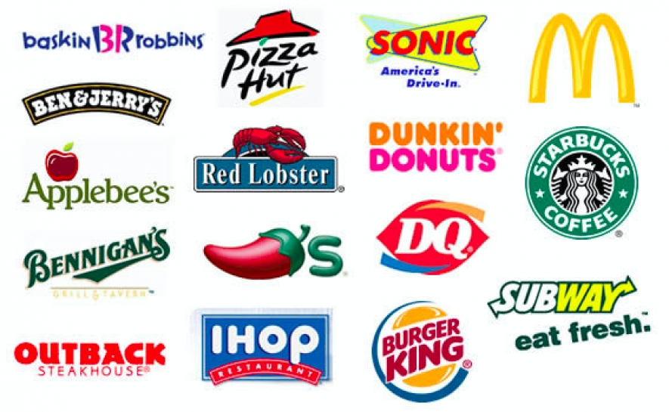
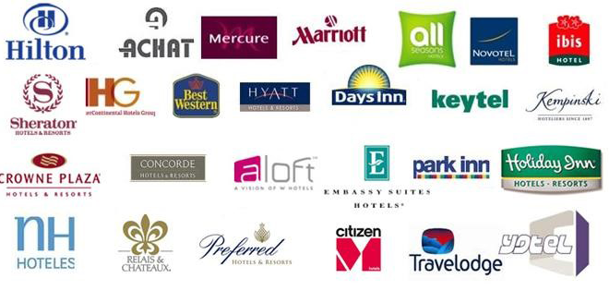
Daily Use Impactful Products
Major Gas Stations – 168,000 in USA, over 281,000,000 autos registered in USA in 2019
Major Fast Foods – 500,000 chains in USA, kids ages 6-14 eat fast food over 157,000,000 per month in USA
Major Hotels - There are 54,200+hotel properties and more than 1.1 billion guests nights annually in the USA.
Household Paper Goods – Over $10,000,000,000 are spent annually on paper goods for the home in the USA.

Slide 6
What We Measure and Why
Sustainability Measurement – Is the company practicing good sustainable practices such as recycling and renewable energy or are they climate deniers and polluters.
5 | 4 | 3 | 2 | 1 | 0
Corporate Culture Measurement – Does the firm have an open and safe environment for employees of all races, genders, and sexual orientation or have they a history of infractions, discrimination, sexual harassment and equal pay disparities
5 | 4 | 3 | 2 | 1 | 0
Political Donation Measurement – Does the company donate to political causes that align with yours? If not you now are equipped with the information to help you make well informed decisions when spending your hard earned money.
L5 | L4 | L3 | L2 | L1 | 0 | R1 | R2 | R3 | R4 | R5

Slide 7
Stand By Your Brand App
SEARCH >
BROWSE CATEGORIES X >
VIEW BOOKMARKS >
BROWSE CATEGORIES >
Major Gas Stations >
Major Fast Food >
Major Hotels >
Household Paper Goods X >

Slide 8
SBYB Dash Board Example
Household Paper Goods >
Paper Products
Dixie X >
Kleenix >
Brawney >
Charmin >
Bounty >
Puffs >
Scotts >
Paper Products
Dixie X >

Slide 9
App Brand Score Example
Dixie >
5 | 4 | 3 | 2 | 1 | 0
Sustainability Measurement colors and number values
5 | 4 | 3 | 2 | 1 | 0
Corporate Culture Measurement colors and number values
L5 | L4 | L3 | L2 | L1 | 0 | R1 | R2 | R3 | R4 | R5
Political Affiliation Measurement colors and number values
Notes: Owner of record is Koch Industries
Sustainability: Climate change deniers
Culture: No major complaints recently, sexual harassment in past
Political: Recent contributions to moderate democrats, donates primarily to republican anti environmental groups.
Alternative Brand >
Consumer Brand Recommendation >

Slide 10
Appendix
Slide 11 – Marketing Strategy
Slide 12 – Monetization Strategy
Slide 13 – Expanded Monetization Strategy
Slide 14 – Sustainable Definitions
Slide 15 – Corporate Culture Definitions
Slide 16 – Political Donations Definitions
Slide 17 - Disclaimers

Slide 11









SBYB Marketing Strategies
SBYB Website
Blog
Email Lists
Facebook
Instagram
Twitter
YouTube
Free news media

Slide 12
Potential Monetization Strategies
$0.99 - $1.29 Phone App
Free Phone App with In-App Ads
Partnerships with Other Shopping Apps –Click-through Rate
SMS Marketing –Text messaging
Free vs. Premium Versions
Strong Content Strategies – Blog
Subscription Services
Data Driven Services – User Behaviors

Slide 13
Expanded Monetization Strategies
Potential Partnerships with Other Shopping Apps –Click-through Rate Model
Gas
Gas Guru
Pit Stop
Gas Buddy
GetUpside
Fast Food
Shipt
Fast Food Finder
My Fast Food
Door Dash
Uber Eats
Hotels
Expedia
Hotels.com
Trivago
Booking.com
Expedia
HotelTonight
Priceline
TripAdvisor
Hotwire
SkyScanner
Household Goods
Goods Mart
Homestyle
Welcome Supermarket
Shipt
Our Groceries Shopping List
AnyList
ShopList
Grocery List
Shopping List Ease
Smart Grocergy List

Slide 14
Sustainable Practices
5 | 4 | 3 | 2 | 1 | 0
The Sustainable Practices Policy of a company establishes goals in nine areas of sustainable practices: green building, clean energy, transportation, climate protection, sustainable operations, waste reduction and recycling, environmentally preferable purchasing, sustainable foodservice, sustainable water systems.
Top 10 sustainable business practices
Empower your employees
Formalize your commitment to sustainability
Turn off lights and electronics
Go energy efficient
Conserve Water
Recycle paper
Reduce business travel
Forge local partnerships
Invest in a digital filing system
Create a Green Team
Sustainable Measurement Key
5. Meets all 10 best environmental practices
4. Meets 7 out 10 best practices
3. Meets 5 out of 10 practices
2. Meets less than 5 out of 10 practices
1. Climate denier and major violator of pollution creating practices
0. Not applicable/No information

Slide 15
Corporate Culture
5 | 4 | 3 | 2 | 1 | 0
Culture Measurement Key
5. Golden with zero complaints and high employee satisfaction
4. Rosey with minimal complaints and good employee satisfaction
3. Pink with a few complaints and moderate employee satisfaction
2. Gray with allegations of employee and fiscal misconduct. Low employee satisfaction
1. Black with numerous complaints and citations. Very low employee satisfaction
0. Not applicable/No information
Corporate culture refers to the beliefs and behaviors that determine how a company's employees and management interact and handle outside business transactions. Often, corporate culture is implied, not expressly defined, and develops organically over time from the cumulative traits of the people the company hires.
According to Robert E. Quinn and Kim S. Cameron at the University of Michigan at Ann Arbor, there are four types of organizational culture:
Clan, Adhocracy, Market, and Hierarchy.

Slide 16
Political Donations
L5 | L4 | L3 | L2 | L1 | 0 | R1 | R2 | R3 | R4 | R5
The term corporate donation refers to any financial contribution made by a corporation to another organization that furthers the contributor's own objectives. Two major kinds of such donations deserve specific consideration, charitable as well as political donations.
Just as water flows downhill, money in politics flows to where the power is. And the Stand By Your Brand APP is here to help you follow the contours and learn about these connections. This section reflects information about the healthy and unhealthy influence money can have on our elections and government politics.
Donation Measurement Key
5. Major partisan donations only
4. Moderate partisan donations only
3. Minimal partisan donations only
2. Donates to some bi-partisan
1. Donates equally to all parties
0. Not applicable/No information

Slide 17
SBYB APP Uses of Publicly Traded Brands
Identify product brands that align with users core values and beliefs
Measures brand/company sustainability historical and current practices
Measure brand/company culture historical record and current practices
Measures brand/company political contributions and affiliations historical record and current practices
All legal disclaimers and noted comments that can positively or negatively reflect the brand/company to be referenced from reliable publicly available sources
All disclaimers, comments, notes, measures, references, and sources are legally reviewed and approved

